Slide 1


Stock Data Analysis Using Spark
Project Planning Presentation
Group 5
Vinit Deshbhratar (001057836)
Siddharth Muthe (0010399679)
Xuewen Xu (001434974)

Slide 2



1. Overview
Provide user an interface to understand trends of the stocks in their portfolio.
Project focuses on facilitating user to execute transformations on historical financial data.
Visualize calculated metrics in Tableau.

Slide 3

2. Demo
localhost:9000

Slide 4

3. Use Cases
New user can sign up and select stocks to be added to the portfolio.
Existing user can see, add and remove stocks from current portfolio.
User can initiate spark jobs on historical data from UI.
User can see the current prices of the stocks in the portfolio.

Slide 5

4. Methodology
Create a functional UI where user can identify stocks to be added to the portfolio.
Perform transformations on historical stock data.
Visualize calculated metrics in Tableau.

Slide 6

5. Data Resources
Historical Data: AlphaVantage
Current data: Finnhub
Historical Data Row Count: 12*10000*(No. of stocks)

Slide 7

6. Milestones
Week 1: Create a UI for user to login and select stocks.
Week 2 and 3: Execute spark job on EMR cluster.
Week 4: Visualization of the transformed data
Week 5: Unit test cases

Slide 8

7. Program Details
Code Language: Scala
Framework: Play
Visualization Tool: Tableau
Storage: Redshift, MySQL, S3
GitHub: https://github.com/vinit2107/CSYE-7200-Project-Grp-5

Slide 9

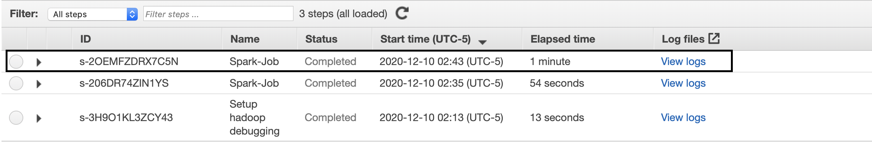
7. Acceptance Criteria
Spark job for historical data should complete in under 1.5 - 2 minutes per stock.

Slide 10
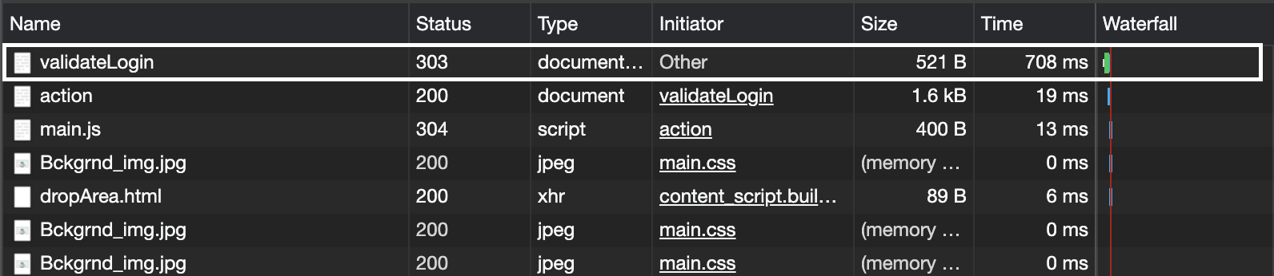
7. Acceptance Criteria
User should be able to login within a second.

Slide 11
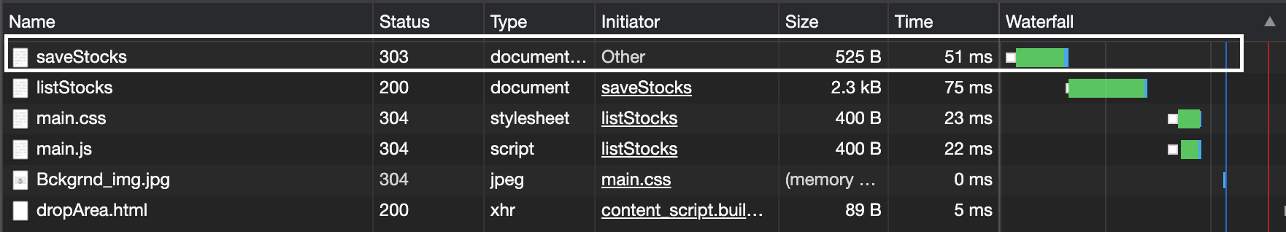
7. Acceptance Criteria
Response time for updating stock should be less than 2 seconds.

Slide 12

8. Goals
Enable user to identify stocks to be added in portfolio.
Providing user convenient way to undergo technical analysis of the stocks.
Provide user an interactive dashboard for understanding the calculated metrics.

Slide 13

9. Scope for improvement
Cluster auto termination after idle period
Select multiple stocks at a time
Integrate visualizations in the UI

Slide 14

Thank you!

